Slide 1

Group 4 Presentation
Sales Performance Insight
Team Members:
Amaka Ihenwe
Esther Jesubi
Olalekan Kolaru
Oluwole Ogundipe
Sharudeen Adebayo
September 6, 2022

Slide 2
Task Outline
01. Problem Statement
02. Dataset Description
Page 3
Page 4
03. Analysis & Visualization
04. AOB
05. Thank You
Page 5
Page 6 & 7
Page 8

Slide 3

Executive Summary
Problem Statement
We are looking into a supermart retail dataset that has daily sales of certain items. The dataset shows sales and profit but failed to show a lot of insights beneficial to the store owner. We aim to investigate this and offer more insight to move the business to the next level.

Slide 4
Dataset Description
This project is a supermart grocery sales dataset that shows important details of daily sales of customers in different regions and cities in a particular state called "Tamil Nadu".
Insights Considered
Which region makes the most profit
Which city makes the most profit
Which category and sub-category makes the most
Which category and sub-category was patronized more
Most Outstanding customer in terms of patronage
In what year did the supermart make the highest average profit?
Correlation between sales and discount

Slide 5
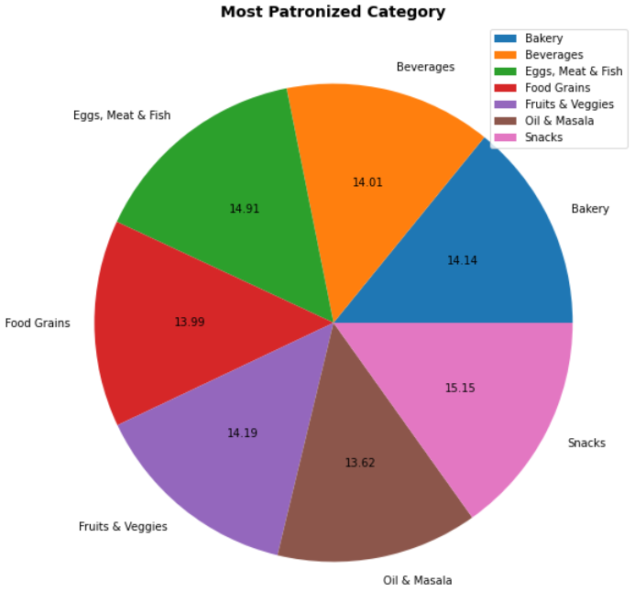
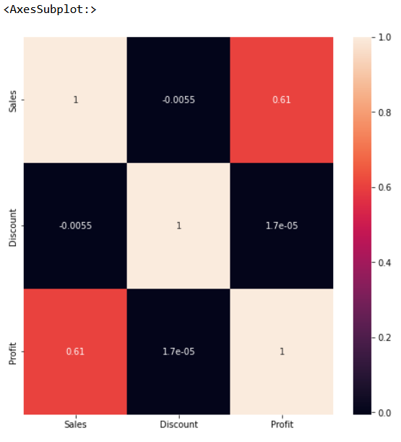
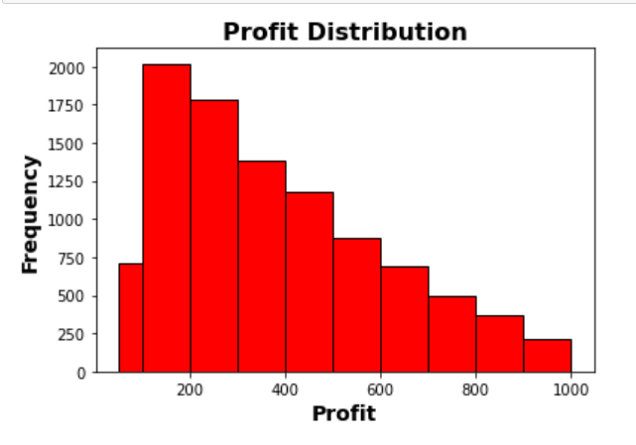
Visuals and Relationships
Univariate, Bivariate, and Multivariate Analysis & Visualization
Bivariate
Multivariate
Univariate
Using a Histogram to show the Profit Distribution
The most patronized Category
correlation between Sales and Profit

Slide 6
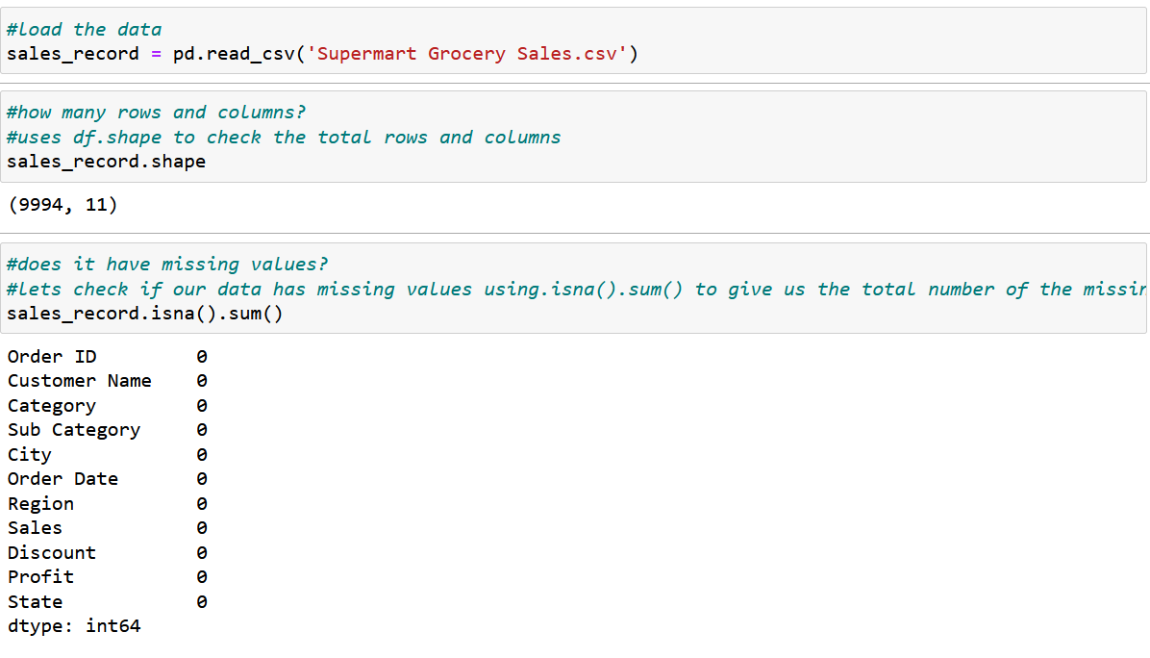
AOB
Data Inspection
Data Source is a CSV dataset downloaded from Kaggle, click on this link to access the data set: https://www.kaggle.com/datasets/mohamedharris/supermart-grocery-sales-retail-analytics-dataset
Supermart dataset has 9994 Rows and 11 columns with no missing values.
From observations, Date data type, and column names will be modified.

Slide 7
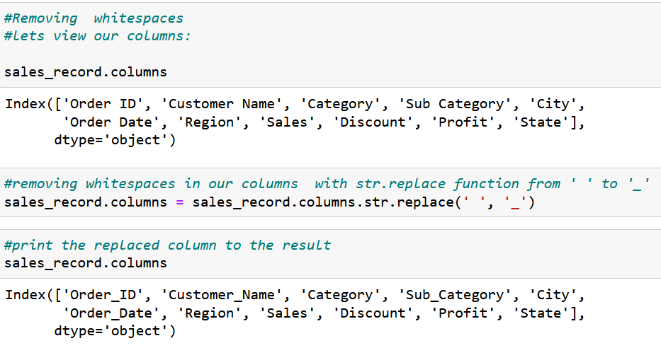
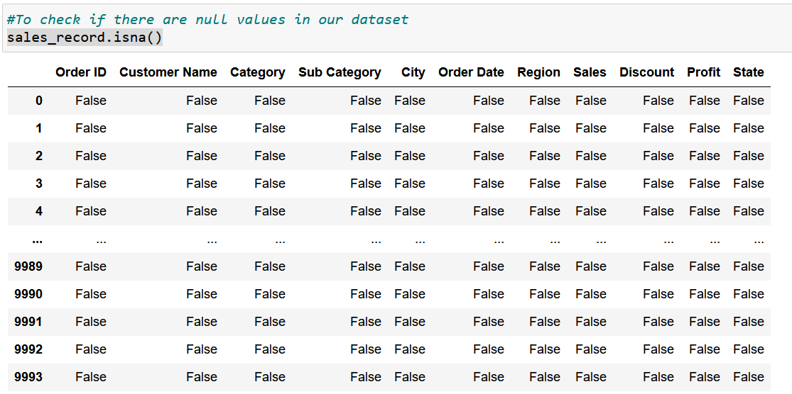
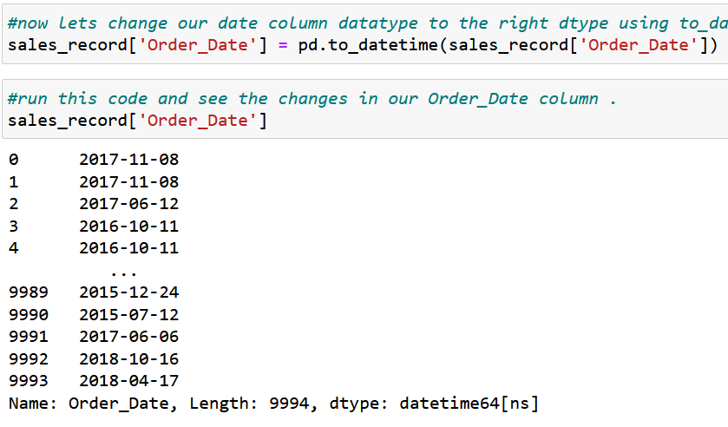
AOB
2. Removed whitespaces
Data Cleaning
1. Checked for NaN
3. Changed the date format

Slide 8

Thank you

